Slide 1
React, Gently
Day 57
<DATE HERE>

Slide 2
A Throwback!

Slide 3

Obstacle #1 – The Great Confusion

Slide 4

Obstacle #2 – The Great Doubt

Slide 5
Silly Instructor…
“Duh. I remember.
I’ve felt dumb everyday since we started.”

Slide 6
Silly Student…
Nah Brah.
You about to feel waaaaay MOARRR dumb.

Slide 7
Welcome to ReactJS!!!

Slide 8

Note: This will not be you.
Do not treat this class as a “spoon feeding” session.

Slide 9

Note: This will be you.
Instead, it’s meant to be an immersion and exposure.

Slide 10
Resources To Use:
Facebook React Official Documentation https://facebook.github.io/react/
Code School React Tutorial https://www.codeschool.com/courses/powering-up-with-react
EggHead.io
Build With React Tutorial http://buildwithreact.com/tutorial
Dev Pen – React in 15 Minutes https://www.youtube.com/watch?v=PGUMRVowdv8
Just YouTube things…
Just read everything..

Slide 11

So… What is React?
React is an open-source Javascript Library developed by Facebook specifically for the task of developing User Interfaces.
It was developed for the purpose of building large apps with data that rapidly changes over time.
It relies on a component-based architecture. Each element of the UI is treated as sub-components of larger components.

Slide 12

But… what is React Not?
React is not a plug-and-play UI beautifier.
React is not a “magic bullet” to building awesome User Interfaces with a touch of a mouse.
It is not as simple to use as libraries like jQuery or Firebase – which are intended for limited use strict purposes.
No. It’s not magic.
Instead, react serves as a sort of “design-paradigm” and organization strategy for building complex front-end applications.

Slide 13
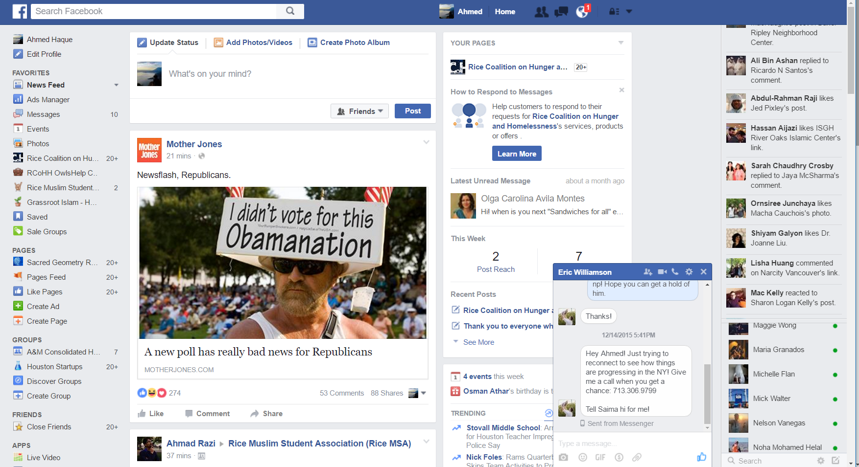
Facebook’s UI Complexities
Facebook’s website buzzes with interactive options, live-updating data, and tightly interacting elements. This poses a challenge to simple DOM manipulation strategies.

Slide 14
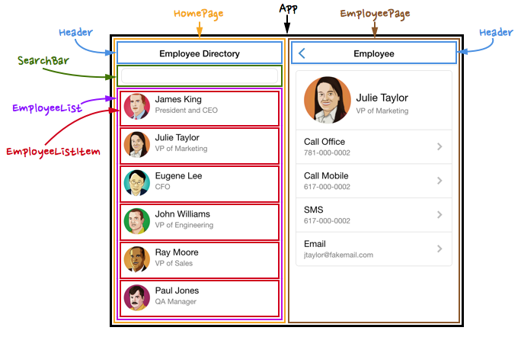
The Concept of Components
Using React, UI elements are broken down into re-usable sub-components.
Each sub-component behaves in a way that it is fully contained

Slide 15
Power of Components!
By separating elements out into components...
Layout and Logic are kept bundled together in a self-contained package.
Components can easily be re-used in various points in the application without needing to be re-coded.
Components can be more easily tested. (i.e. having one re-usable component means only one UI element needs to be tested).
For complex applications each of these can be critical in finding bugs and saving time.

Slide 16
Data Shifting Applications

Slide 17
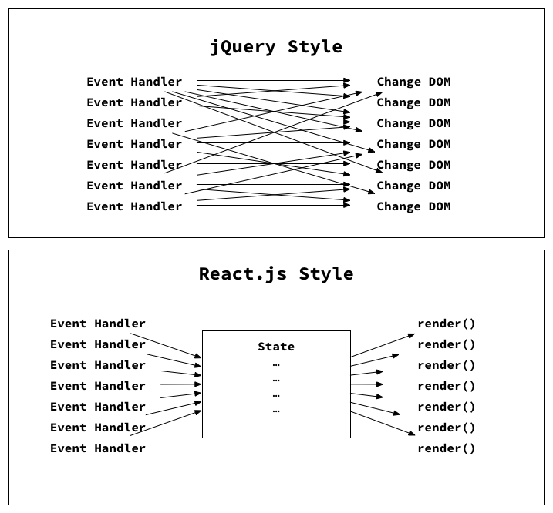
Why Can’t I jQuery Everything?
Jquery
Without an organization structure, code quickly become a series of erratic DOM Manipulations
React
In contrast, React utilizes a state or Virtual DOM that acts as a middle man with pre-defined rules for how each component will behave.

Slide 18
Rapid Data Changes: Option #1 –jQuery
Data-Driven Events
DOM
Article Comments
Users Signed on
Weather Forecast
Newsfeed of articles
Messages Sent
Constantly manipulating DOM is slow.

Slide 19
Rapid Data Changes: Option #2 - React
Data-Driven Events
DOM
Article Comments
Virtual DOM
Users Signed on
Weather Forecast
Newsfeed of articles
Messages Sent
Virtual DOM serves as intermediary

Slide 20
Digging into Docs

Slide 21
Documentation Immersion
With your Project Groups…
Answer each of the questions slacked out to you.
Really try on this activity!

Slide 22
A Gentle Intro

Slide 23
Questions

